Slide 1
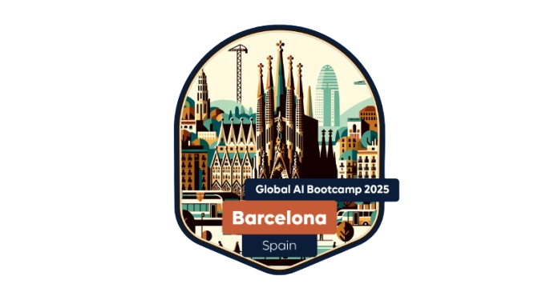
Getting started with Generative AI in Azure
Speaker name

Slide 2

Getting Started with AI Agents
The foundation of Generative AI in Azure
Name
Job title Company
Notes:
Hi everyone, a warm welcome to this session on agentic AI and how to get started with the Azure AI Agent Service

Slide 3
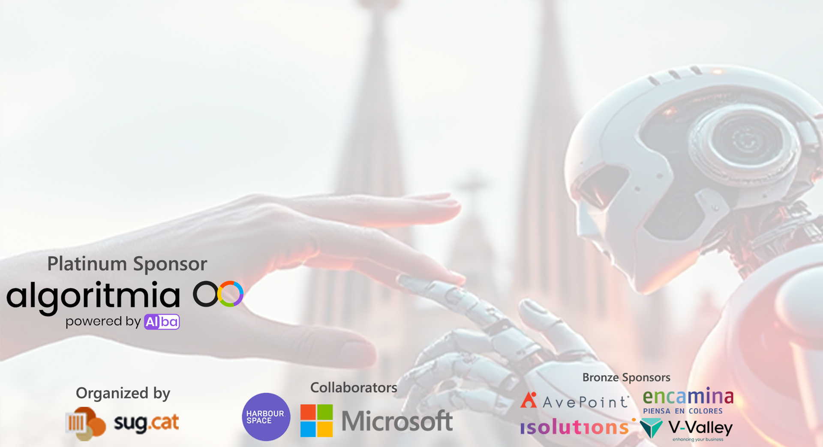
THANK YOU SPONSORS

Slide 4

Every app will be reinvented with AI
Notes:
I want to kick things off with a statement that perfectly captures the essence of our discussion: 'Every app will be reinvented with AI.'
Generative AI is at the forefront of this revolution. Unlike traditional AI that analyzes existing data to make predictions, generative AI creates new content. This could be anything from generating human-like text, creating realistic images, to composing music. The possibilities are truly endless.
In the past few years, we've seen generative AI make incredible strides. Tools like GPT-3 and DALL-E have shown us how AI can write coherent essays, generate artwork from text descriptions, and even develop new software code. These advancements are not just theoretical; they are being integrated into real-world applications, transforming industries from entertainment to healthcare.
Today, we'll explore how generative AI works, showcase some cutting-edge applications, and discuss how you can leverage Azure to bring your AI-powered ideas to life. Let's dive into the future where every app is reimagined with the power of AI.

Slide 5
Demo
Assistant API
Speaker name
Notes:
Let’s have a look at this demo to understand what AI is capable to do today.
- Text to Speech Avatar - Live Chat Avatar
- Video Translation with Personal Neural Voice

Slide 6
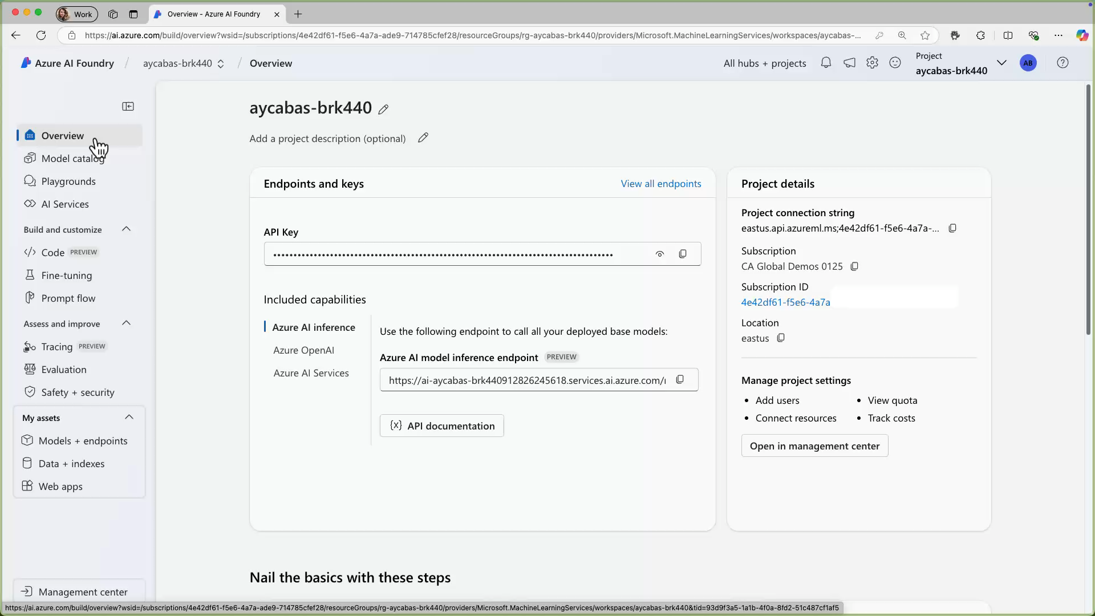
Let’s build
Notes:
https://github.com/aycabas/aitour-generative-ai-in-azure/tree/main/session-delivery-resources/agent

Slide 7
THANK YOU SPONSORS

Slide 8

Thank you
Notes:
All the demos are here!

